Slide 1
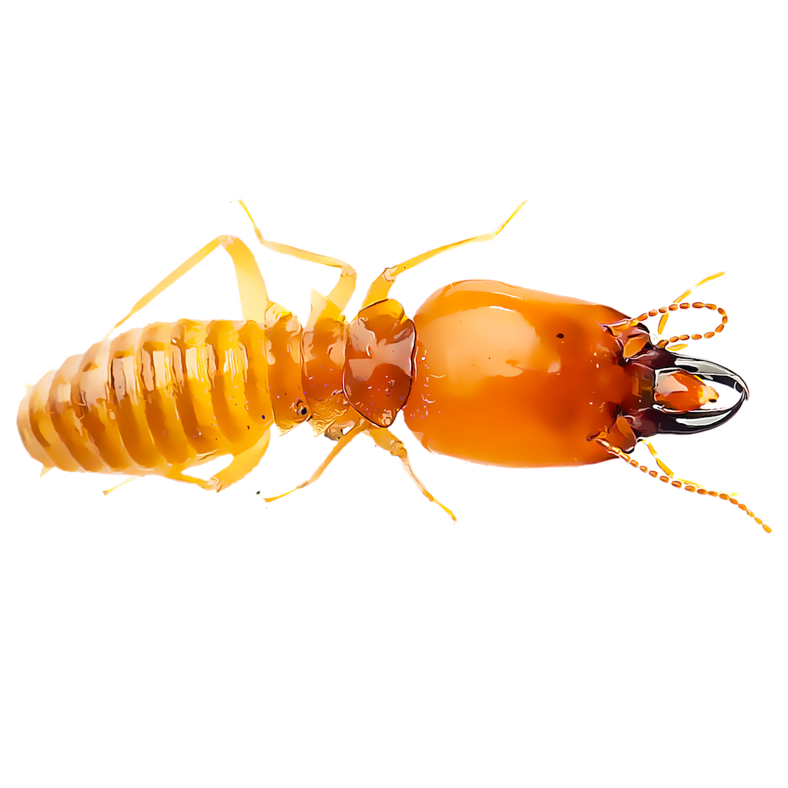
The Evolutionary History of Termites as Inferred from 66 Mitochondrial Genomes
AUTHORS
Thomas Bourguignon, Nathan Lo, Stephen L. Cameron, Jan Sobotnık, Yoshinobu Hayashi, Shuji Shigenobu, Dai Watanabe, Yves Roisin, Toru Miura, Theodore A. Evans
SPEAKER
Guglielmo Rambaldelli

Slide 2
TERMITES
-evolved from wood-feeding cockroaches, and form a sister group with the cockroach genus Cryptocercus.
-diverged from cryptocercid roaches during the late Jurassic (136–170 Ma).
-first undisputed termite fossils are from
the early Cretaceous, 110–135 Ma

Slide 3
AIM
-Robust phylogenetic tree
-Date termite clades
-Disentangle distribution patterns of extant termites

Slide 4
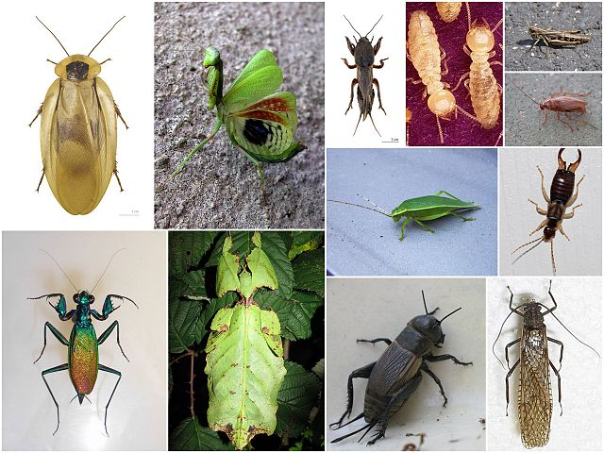
METHODS
-Complete mitochondrial genomes of the 48 termite species + 18 previously sequenced.
-7 polyneopteran insect outgroups.
-16kb mitochondrial genome:
    22 transfer RNAs
    13 protein-coding genes
    2 ribosomal RNA genes

Slide 5
METHODS
-HiSeq2000 sequencing
-Baysian and ML
-Partition: codon,genes,optimal (Partition Finder)
-With or without third codon position
-Uncorrelated lognormal relaxed clocks

Slide 6
METHODS
-6 Bayesian phylogeny tree
-12 Maximum Likelihood tree(GTRGAMMA and CAT)
-2 to 20 million generation
-Standard Partition Finder partition
-NO third codon

Slide 7
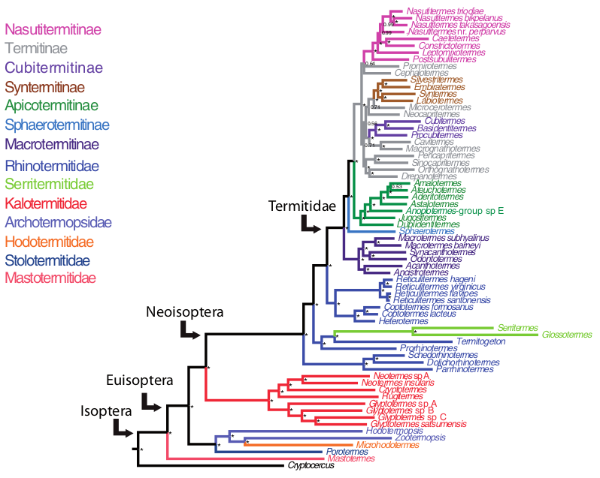
RESULTS: Tree
-Termitinae is the only polyphylectic subfamily
-Macrotermitinae is sister with Termitidae

Slide 8
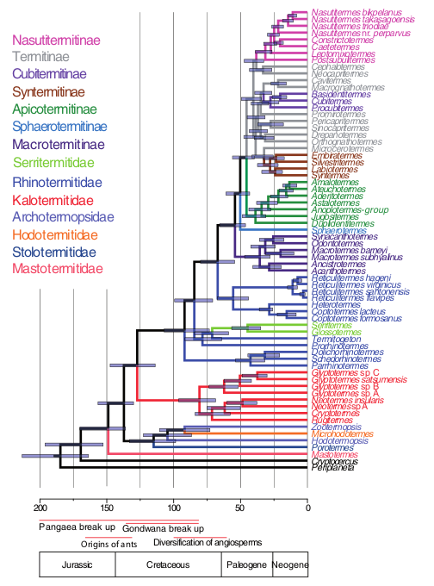
RESULTS: Time Tree
-Third codon position deleted
-Bar : 95% Cls
-High nodal support except for termitid, Termitinae and Syntermitinae

Slide 9
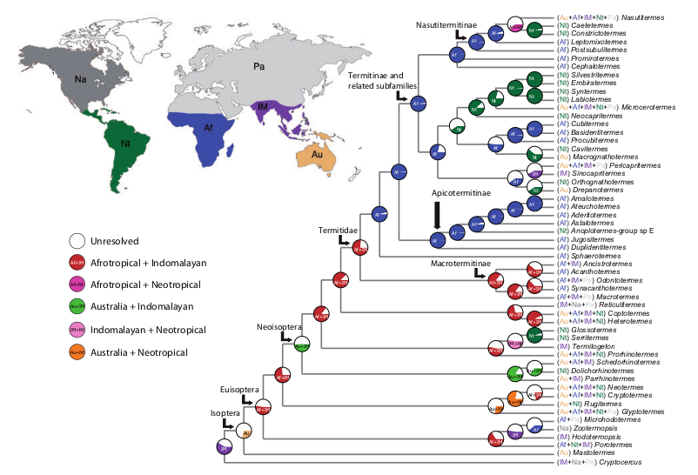
RESULTS: Biogeographic Analysis

Slide 10
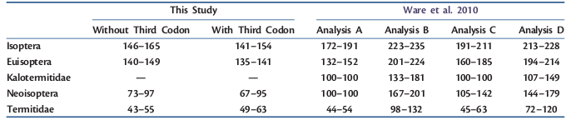
DISCUSSION
-Origin: 150 Ma
-Termitidae common ancestor: 54 Ma
-Soil Feeding: 25 Ma

Slide 11
DISCUSSION
-first termites: second half of jurassic, end breackup of pangea start gondwana brackup.
-Therefore dispersal followed by diversification is the mechanism responsible for the distribution of modern Termitidae species
-Absence of Macrotermitinae in South America and Australia (missing fungi)

